Slide 1
IMPLEMENTATION OF A
MULTI SENSOR BASED SYSTEM
FOR ENVIRONMENTAL CONDITIONS
MONITORING IN A SMALL-SCALE GREENHOUSE
Student: Nicu-Serban POP
Supervisor: Șl. dr. eng. Raul Ciprian IONEL
Politehnica University Timisoara

Slide 2
Purpose
Make gardening easier
Remote Control
Continuous Monitoring
Data History Graph

Slide 3
Overview
Hardware:
Four types of sensors
Two types of actuators
LCD
Software:
Remote Control
Wireless Communication
Multiple UIs.
Multiple Users.

Slide 4
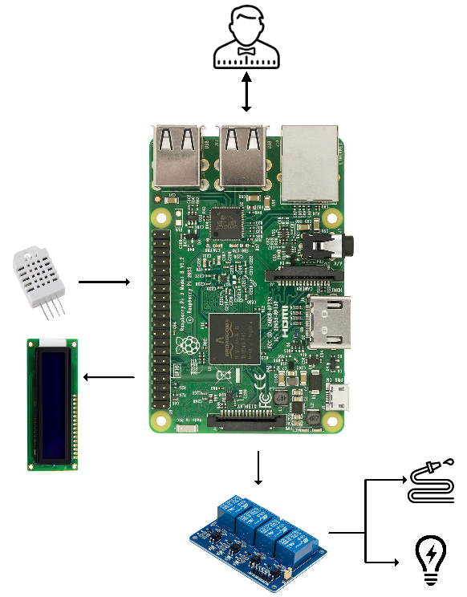
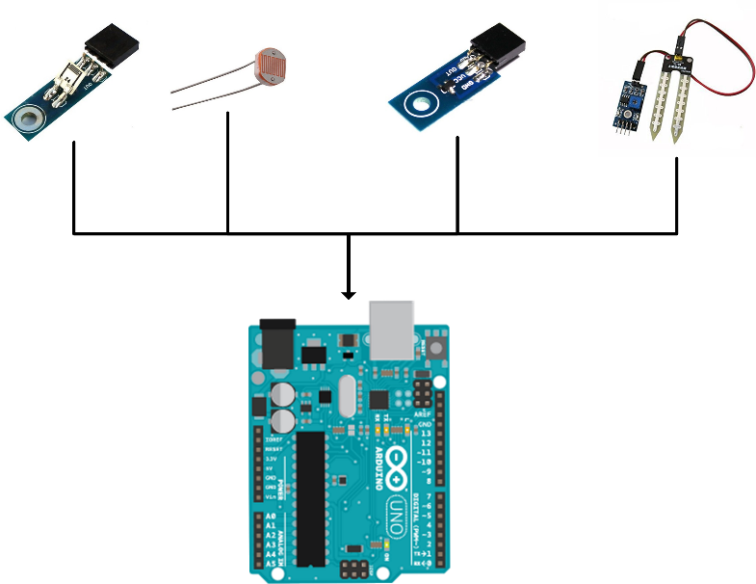
Hardware Implementation
Arduino Sensors:
Light
Temperature
Air Humidity
Soil Humidity
Raspberry Pi Actuators:
Light Bulb
Water Pump

Slide 5
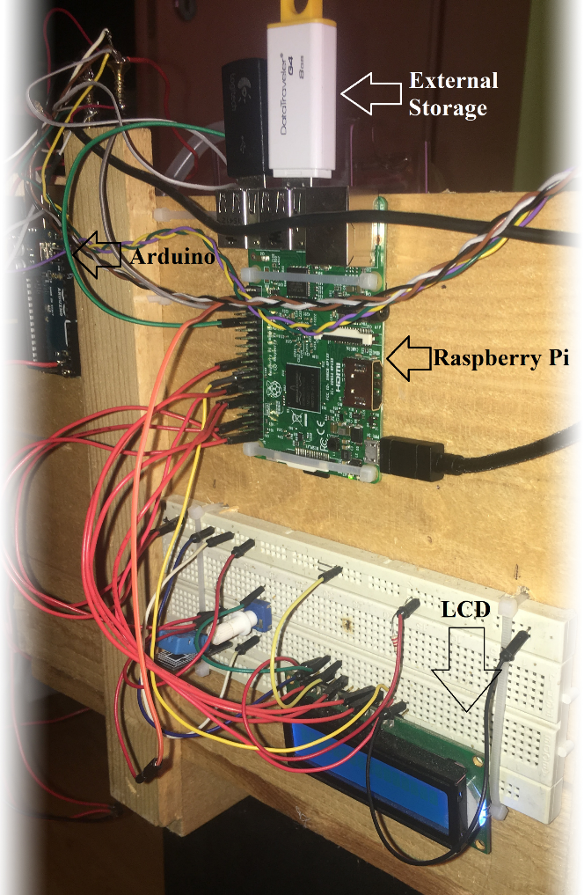
Hardware Functionality

Slide 6
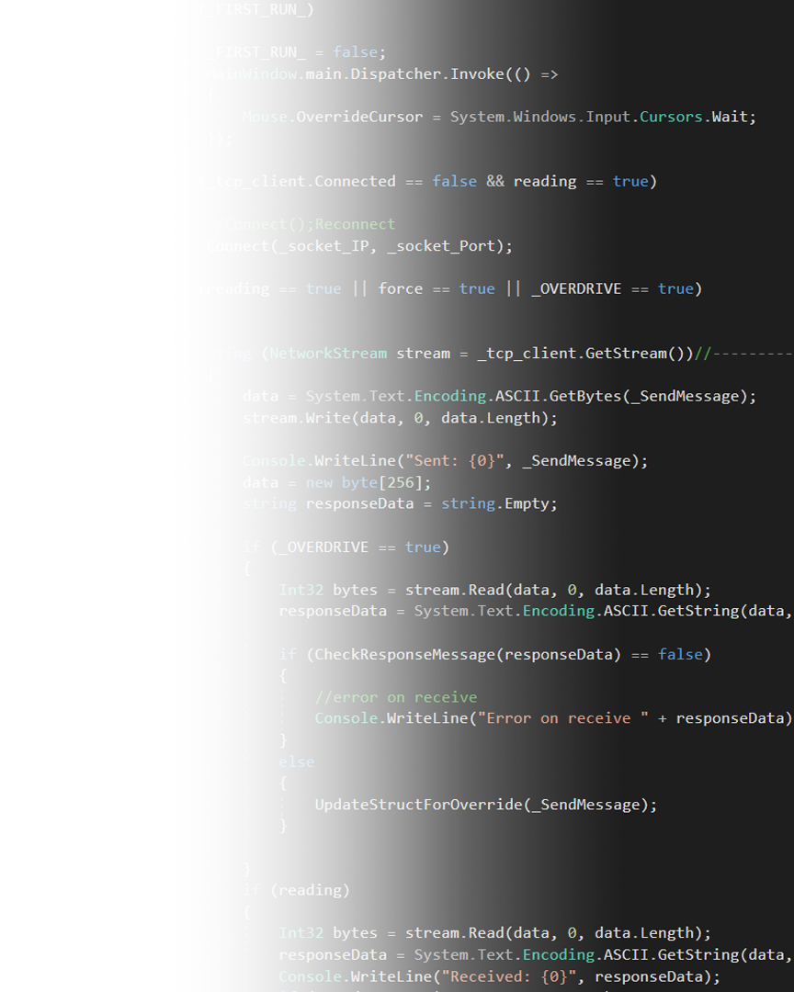
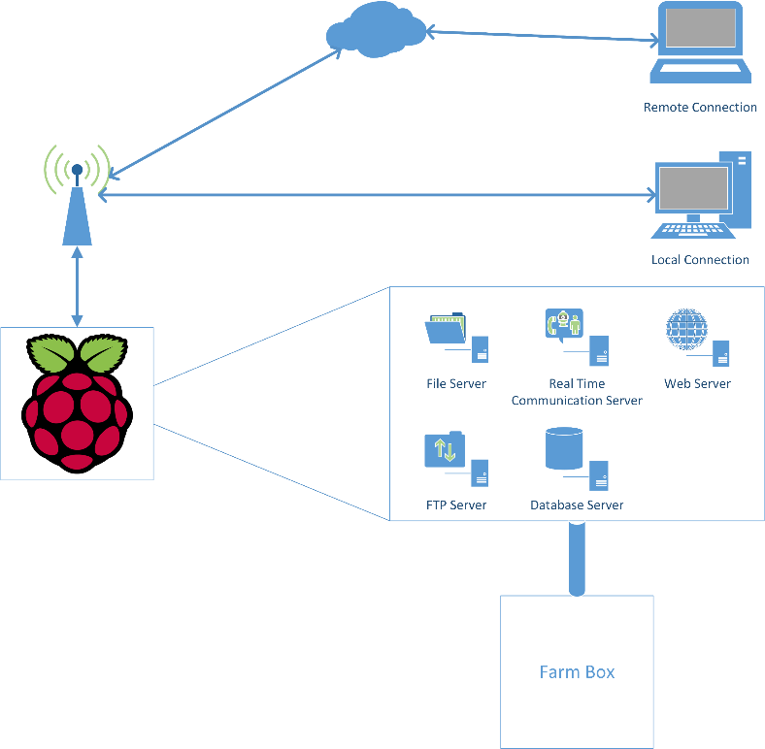
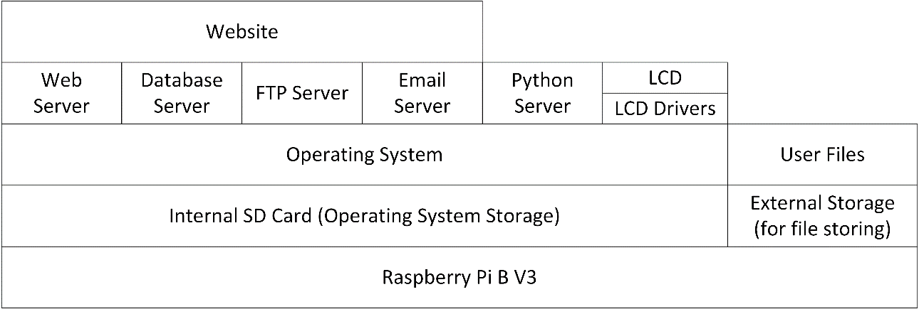
Software Implementation
Arduino ADC
Serial Communication
Python3 Server
Multiple Servers
PHP+MySQL Website
C# Desktop Application

Slide 7
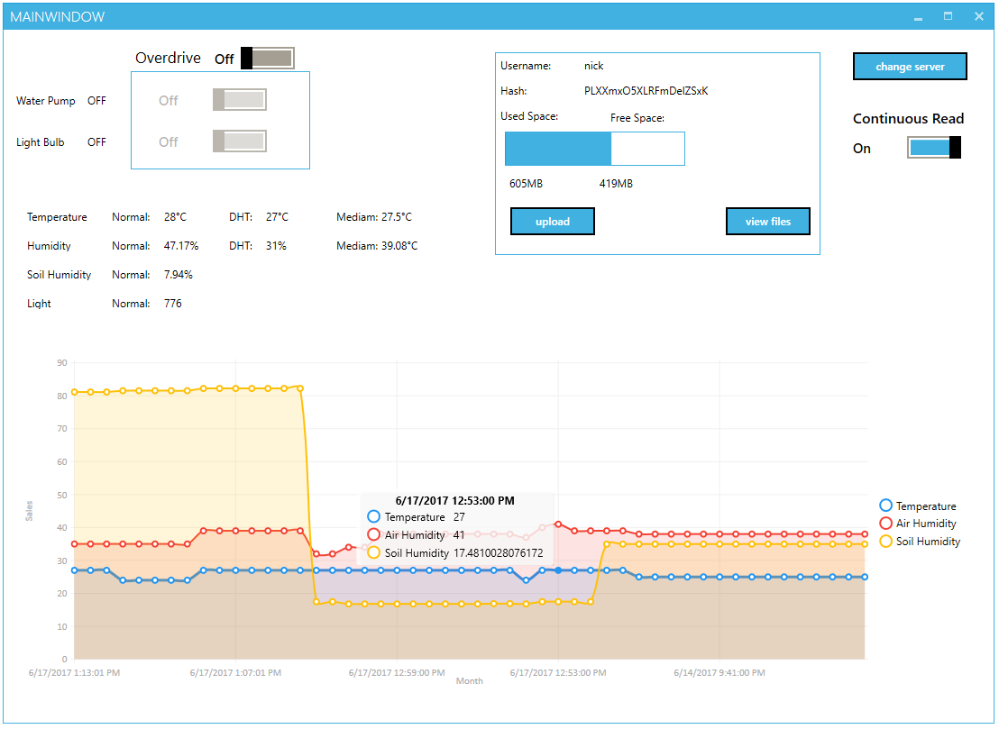
Data Acquisition
Website
Desktop Application

Slide 8
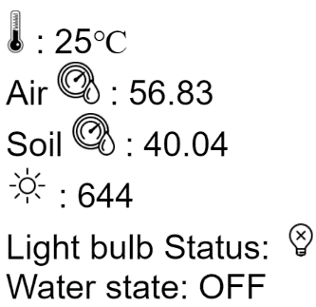
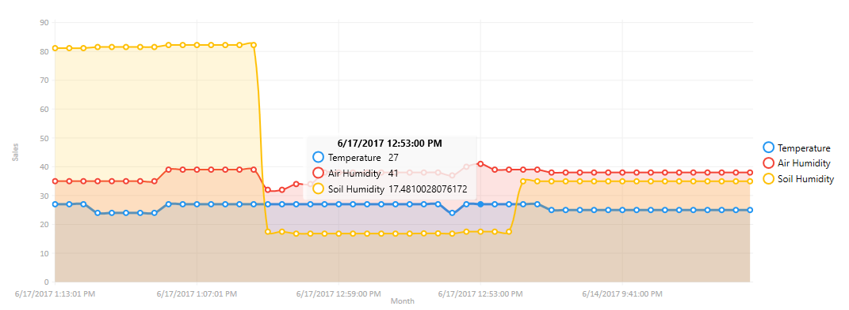
Experimental Data
Light Sensor $→$ Light Bulb
Moisture Sensor $→$ Water Pump
Data Graph

Slide 9
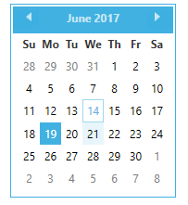
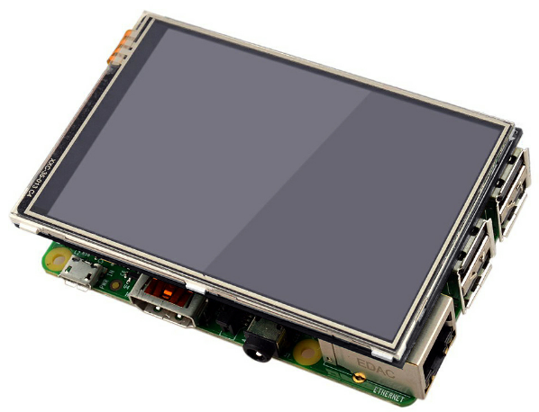
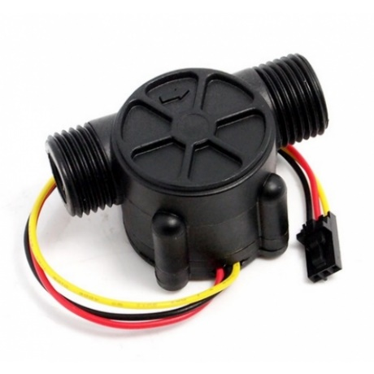
Future Development
Better Wire Management
Calendar Schedule
Exterior Display
Responsive Data Graph
Flow Meter
Multiple Sensors
Webcam streaming for application and website

Slide 10
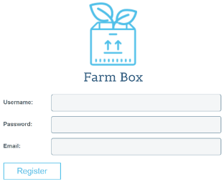
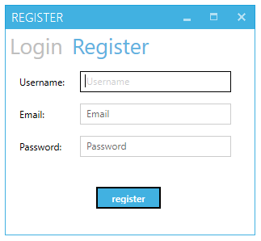
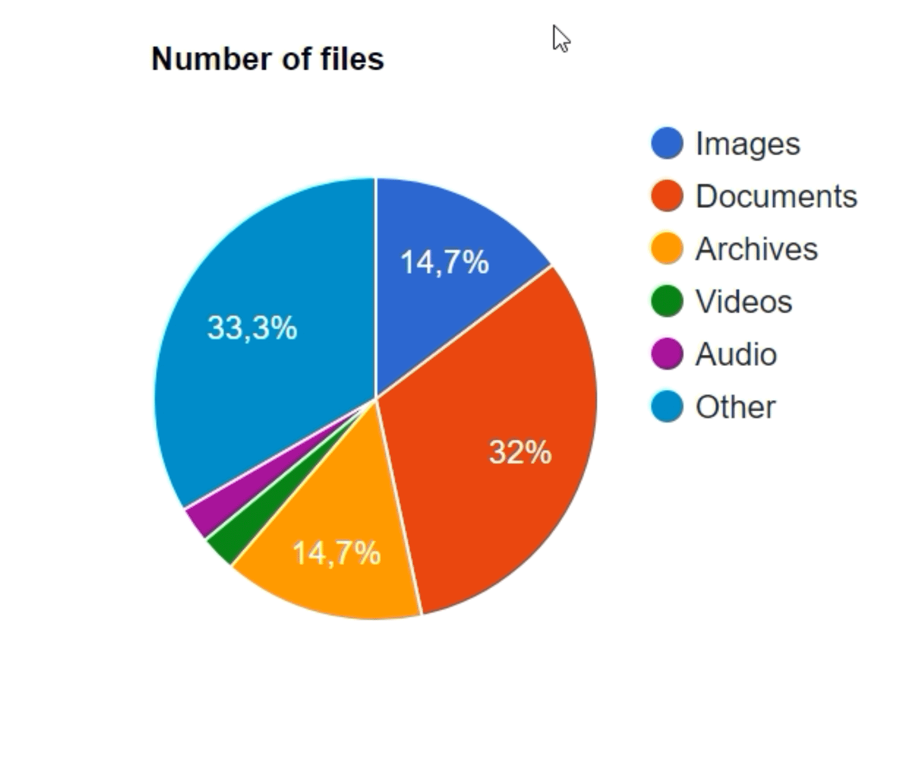
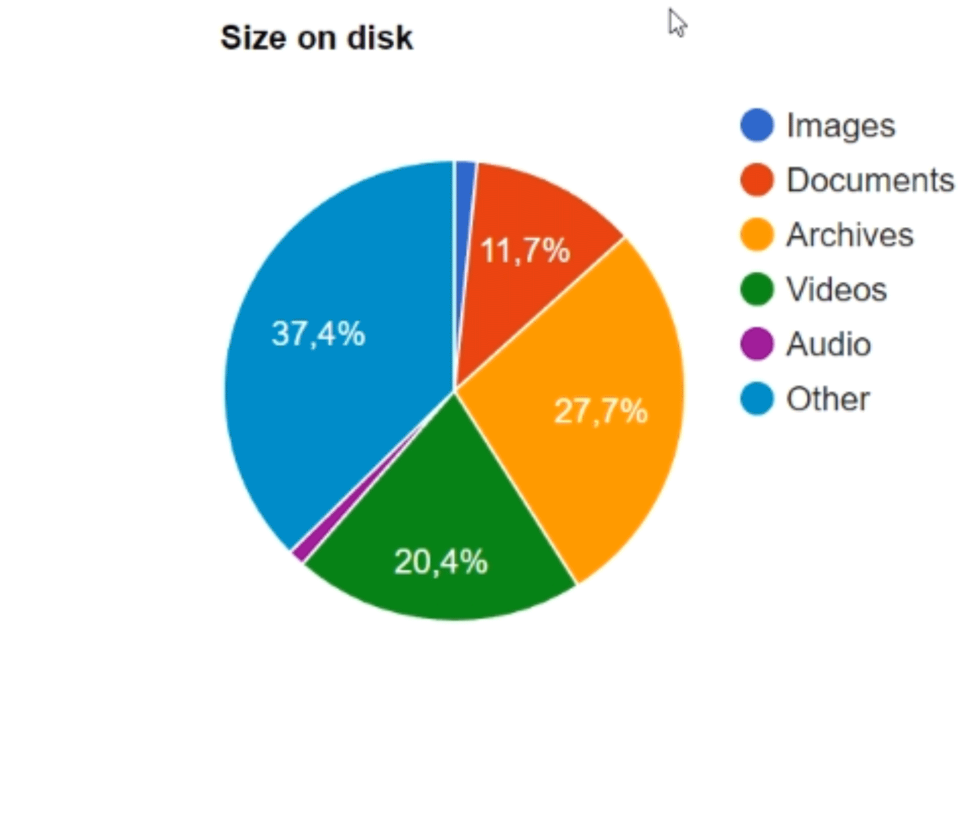
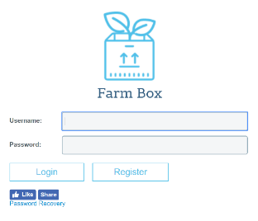
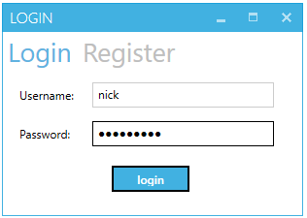
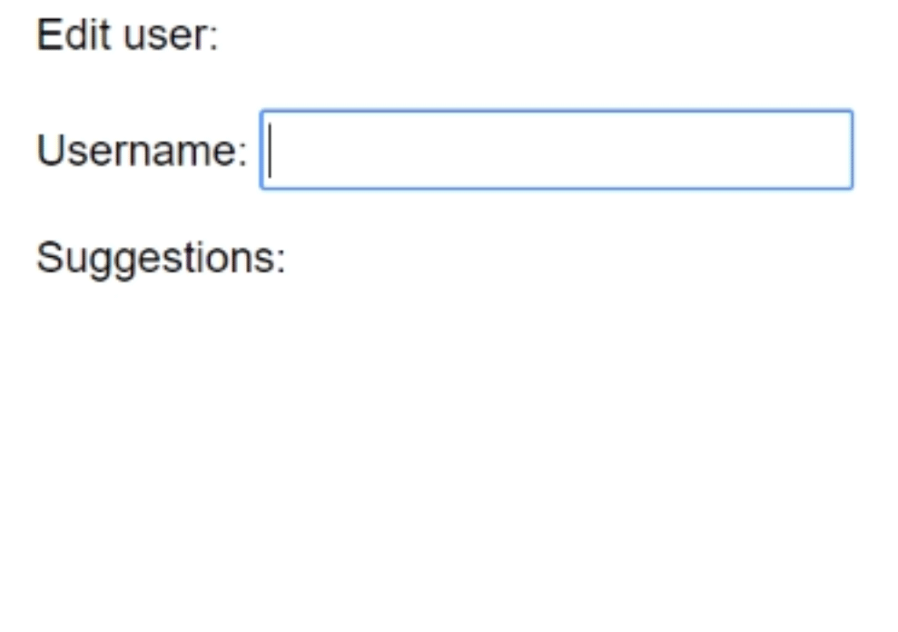
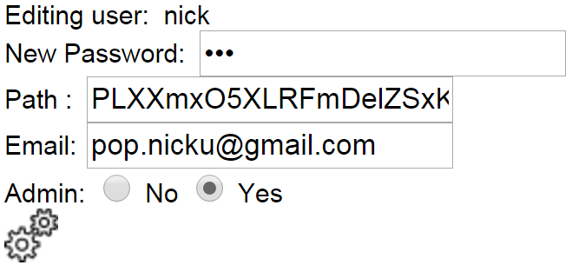
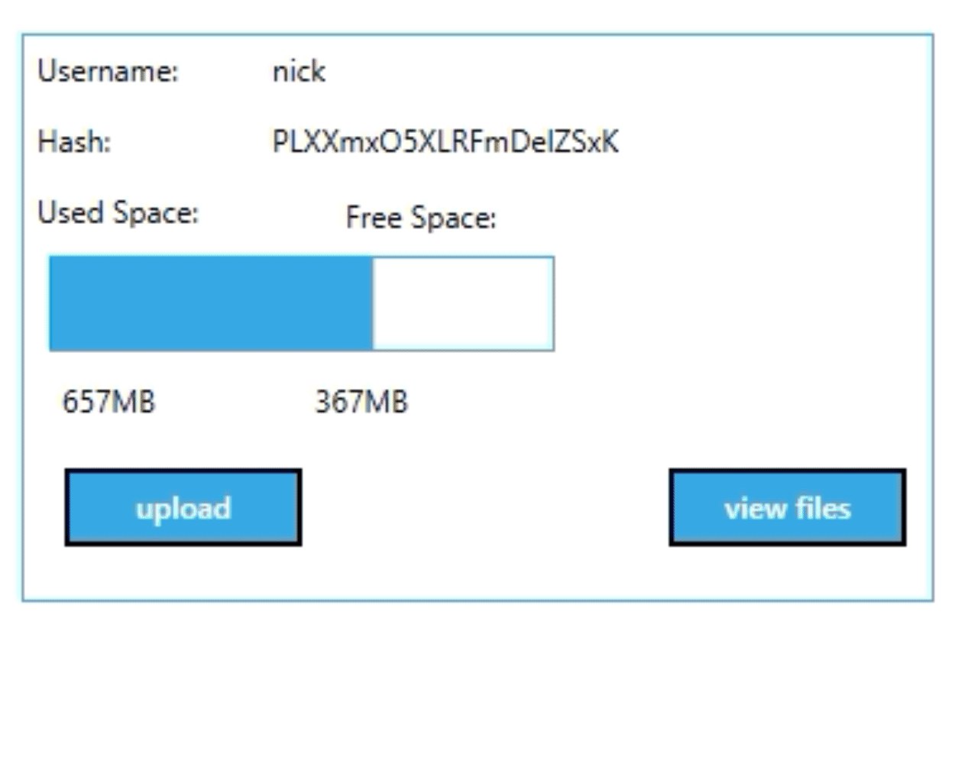
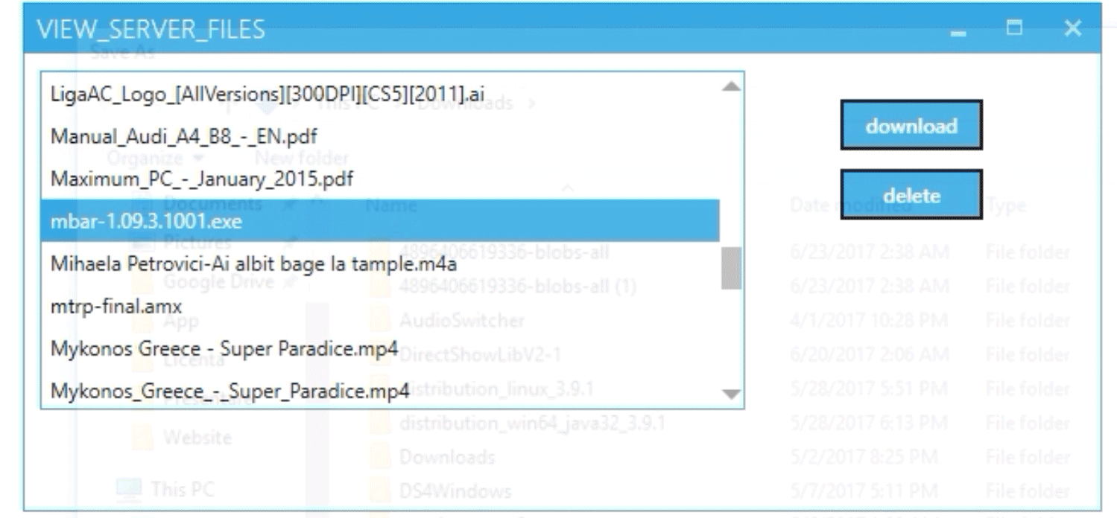
Extra Features

Slide 11
Thank you!

